Slide 1
Express Server with React Client
Mathew Kott,
Rosalinda Gutierrez,
Kal McClure,
Latham Graham
Notes:
Team members Mathew Nevish, Rosalinda Gutierrez, Kal McClure, and Latham Graham

Slide 2
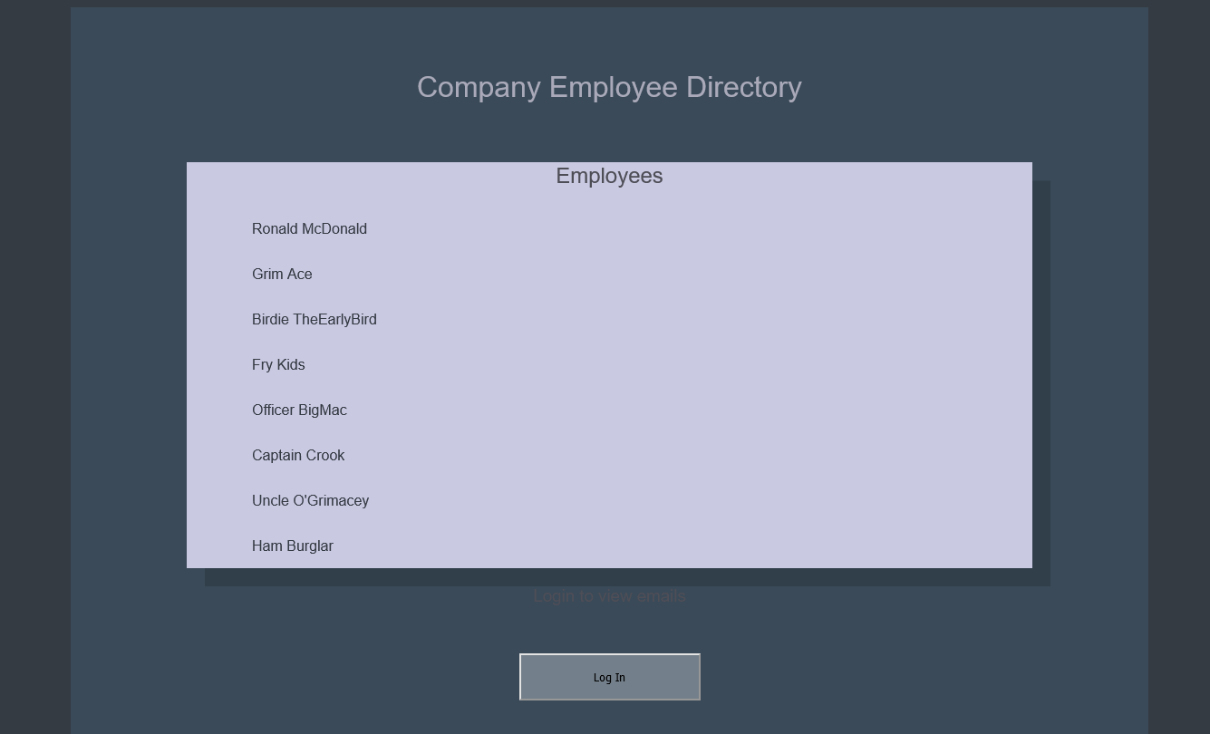
Landing Page

Slide 3
Overview
A RESTful API was created using:
Javascript for function execution
Node.js libraries
Used Express to create a server
Used PostgreSQL for the database
Front End Application was implemented using React

Slide 4
Functionality
Clients of the API are able to log into the API and then provide data to authorized clients
Usage of the project is for displaying employee names and emails for authorized users for a company in any easy to use, accessible app
Authentication of users was implemented using Auth0 security protocol with the use of JSON Web tokens

Slide 5
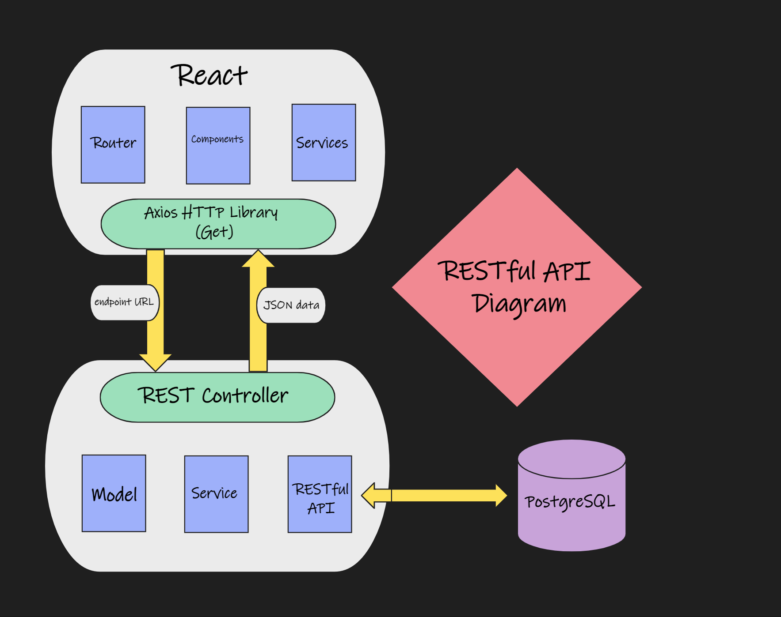
Diagram

Slide 6
Thank You

